Slide 1


Integrated Development Environment for Social Network Analysis
By
Akshay Mallya – 1PI10CS010
Saikiran A – 1PI10CS076
Vikyath Harekal – 1PI10CS116
Project Guide: Prof. Nitin V Pujari , HOD, PESIT-CSE

Slide 2
Current Scenario
Even though different proprietary Social Networking Engines such as Facebook, Twitter generate big data sets, collection and presentation of such data will come under certain privacy policies imposed on the users.
A commonly overlooked privacy problem is use of one’s own accounts - and associated friends' - to collect data that participants believe is limited to their "friends" network.
This highlights the importance of having a separate system which supports users to analyze data from their own social network at their own wish without any terms and conditions detrimental for research.

Slide 3
Elgg : An open source social networking engine
Elgg is an open source social networking engine that provides a robust framework on which to build all kinds of social environments, from a campus wide social network for a university, or an internal collaborative platform for an organization.
Elgg provides a powerful data model making the creation of different entities simple.
Elgg comes with advanced user management and administration, social networking, cross-site tagging, powerful access control lists, internationalization support, multiple view support (eg cell phones, iPhone), an advanced templating engine, a widget framework and more.

Slide 4
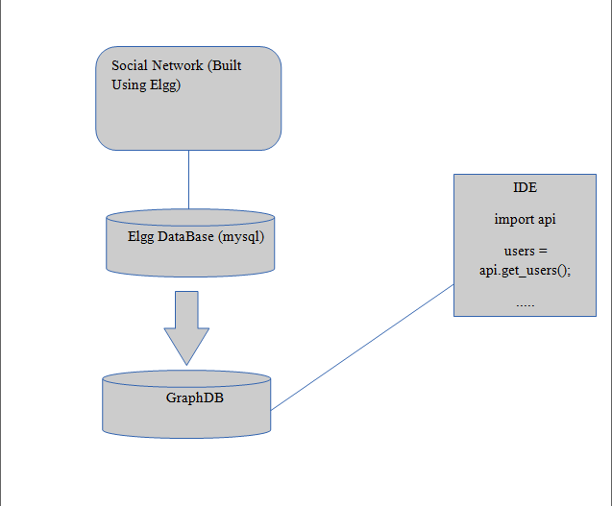




Slide 5
Role of Neo4j
Neo4j is highly scalable, robust native graph database.
We fetch the data model from mySql database and store it in graph database created using different features of Neo4j.
According the study, accessing the Neo4j data is 377 times faster than doing the same on a mySql database

Slide 6

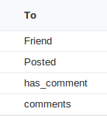
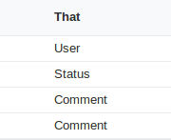
A sample graph db architecture
status
User 1
User 2
Posts
Has
_comment
Friend
Comment
Friend
comments
User 3

Slide 7
Dealing with two Data Stores
We picked a common approach to manage our data after determining that –
The Existing database, MySQL in our case, would continue to be primary system of record
Neo4j would be a secondary data store with a much small subset of data used in two specific ways –
OLTP mode where it is essential to the Analysis to have some questions answered in real time and therefore have certain sets of data as current as possible
Batch mode where some data is collected and processed in a delayed manner.

Slide 8
IDE
We provide an IDE with programmable python interface for the end user to analyze the Social Network
The Python Interface provides all the basic functionalities required for the developer.
To name a few :
get_all_users()
get_friend_list(user_id)
get_posts(user_id, since)

Slide 9
What else ?
We provide developer with an option to download the graph db in JSON format for his offline use.
The user can also manually extend the API to fetch more and more specific data other than the basic operations which are provided by default.
Since this API is made to work on any social network built on elgg, the graph model can be customized in accordance with the social network.

Slide 10
THANK YOU

